Slide 1
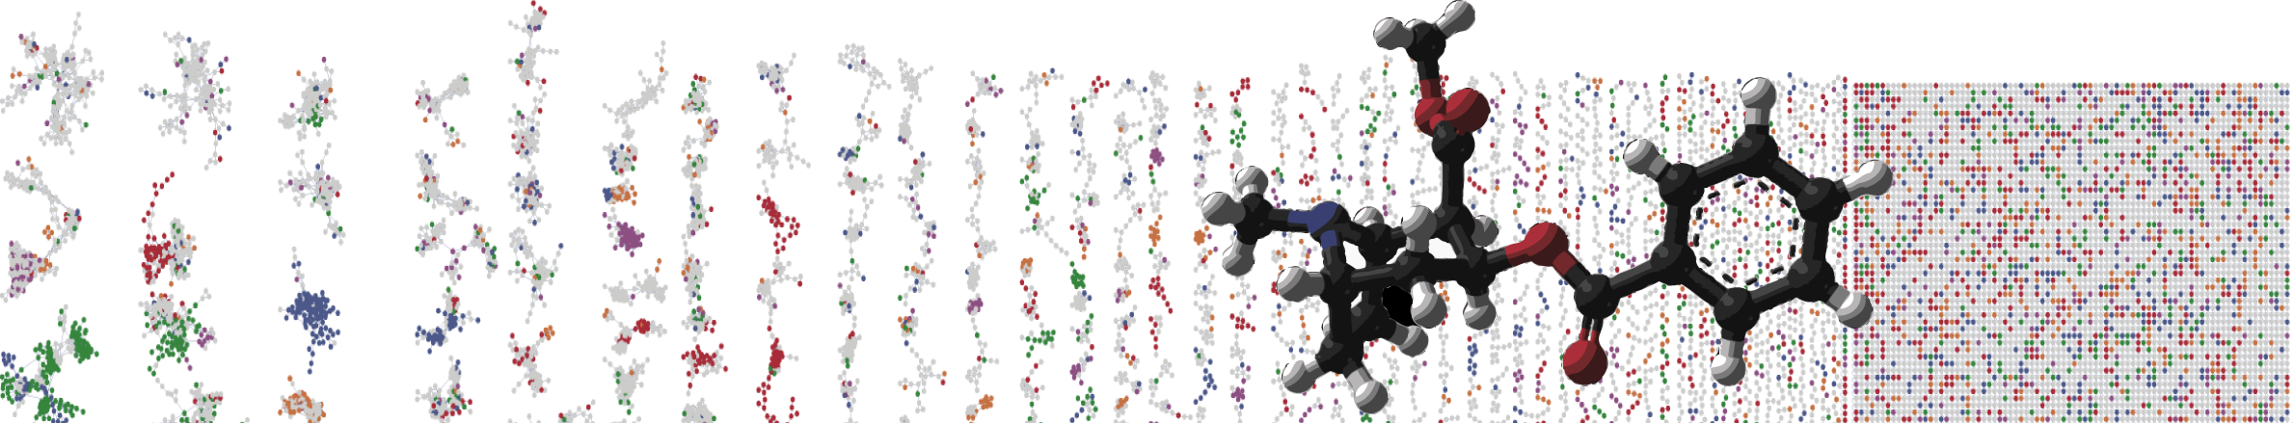


GNPS Molecular Networking Enhancer
Hands On
Allegra Aron
Alan Jarmusch
Mingxun Wang
University of California - San Diego

Slide 2
GNPS Documentation
Classical Molecular Network
https://ccms-ucsd.github.io/GNPSDocumentation/networking/
Feature Based Molecular Networking
https://ccms-ucsd.github.io/GNPSDocumentation/featurebasedmolecularnetworking/
Merge Network Polarity
https://ccms-ucsd.github.io/GNPSDocumentation/mergepolarity/

Slide 3
What do we need?
Positive Molecular Network Job
https://gnps.ucsd.edu/ProteoSAFe/status.jsp?task=0834479d2e2c487994aa6f68253a209d
Negative Molecular Network Job
https://gnps.ucsd.edu/ProteoSAFe/status.jsp?task=a40b5a63ef4d4e16830a7293f5a3181f

Slide 4
Merged Network
https://proteomics2.ucsd.edu/ProteoSAFe/status.jsp?task=34a6a40274c341d0b51fd7d3d974fe2c

Slide 5
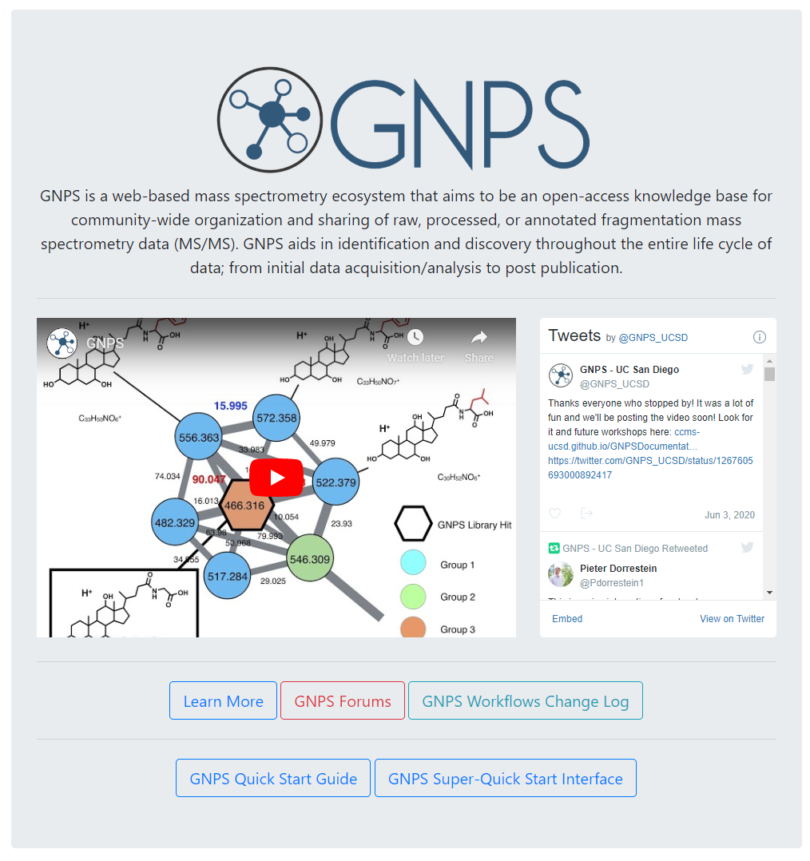
Go to gnps.ucsd.edu
Create GNPS Account
Click on Learn More

Slide 6
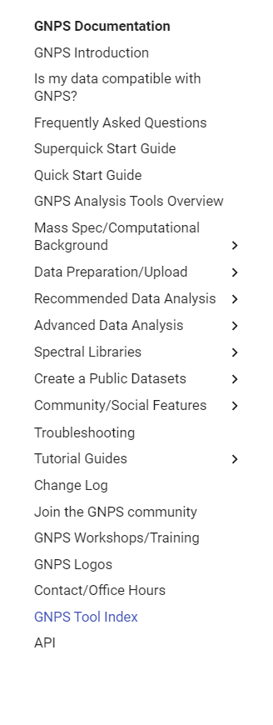
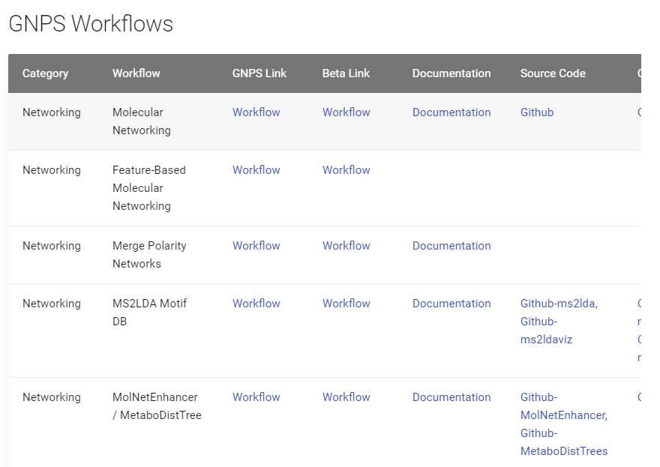
Go to Tool Index
Find Merge Polarity Networks
Link

Slide 7
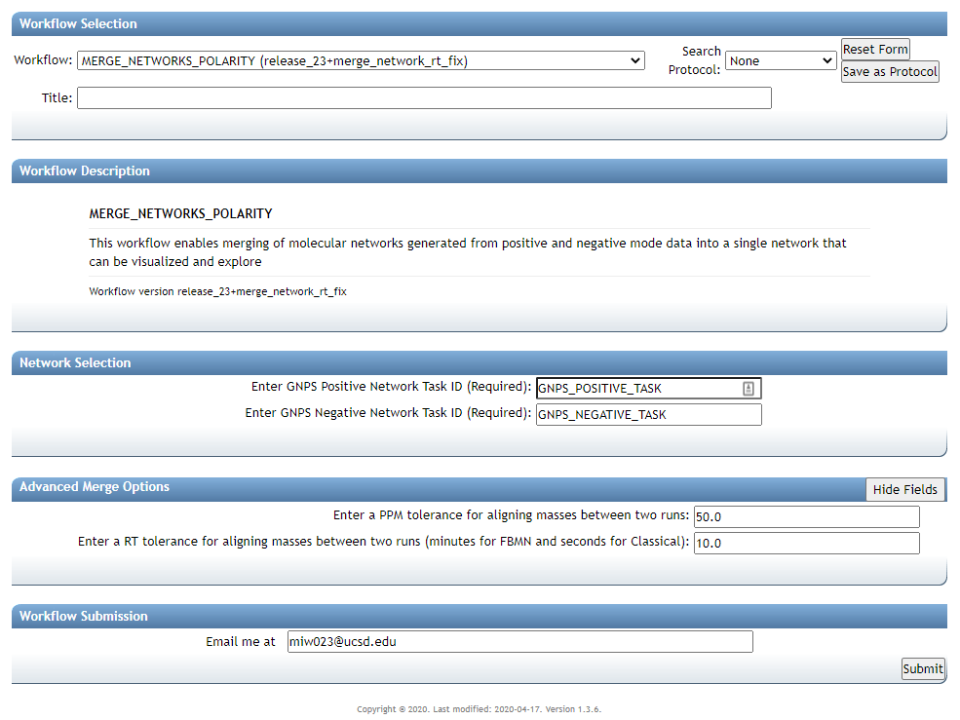

Slide 9
Positive Molecular Network Job
https://gnps.ucsd.edu/ProteoSAFe/status.jsp?task=0834479d2e2c487994aa6f68253a209d
0834479d2e2c487994aa6f68253a209d

Slide 10
Negative Molecular Network Job
https://gnps.ucsd.edu/ProteoSAFe/status.jsp?task=a40b5a63ef4d4e16830a7293f5a3181f
a40b5a63ef4d4e16830a7293f5a3181f

Slide 11
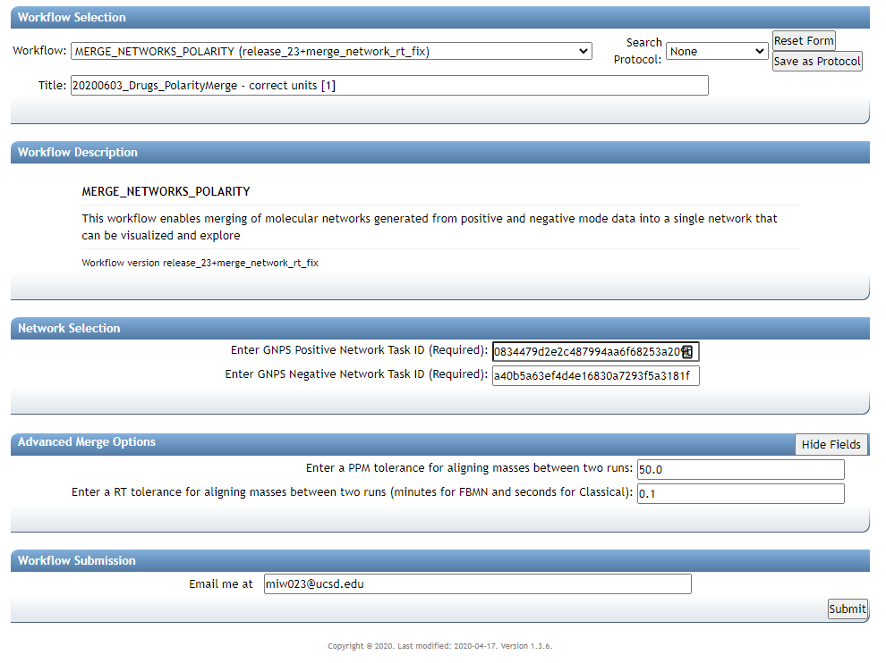
FBMN – in minutes
Classical Network - seconds

Slide 12
Add Email
Submit Network

Slide 13
Merged Network
https://proteomics2.ucsd.edu/ProteoSAFe/status.jsp?task=34a6a40274c341d0b51fd7d3d974fe2c

Slide 14
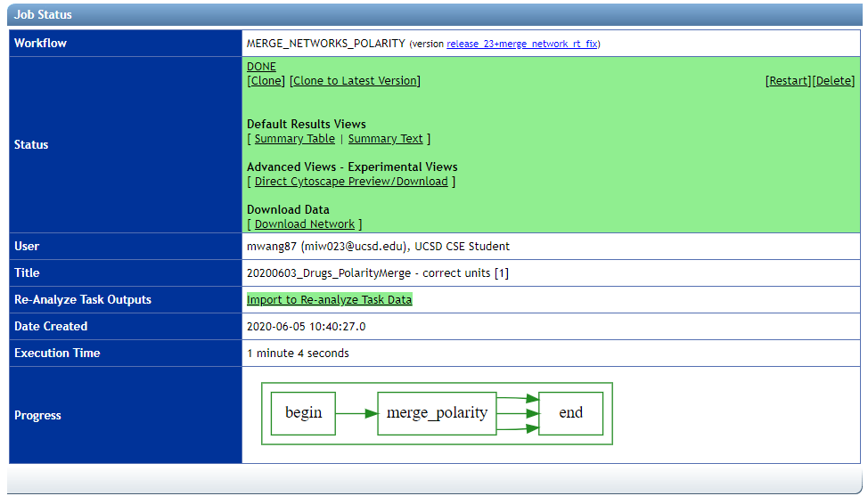

Slide 16
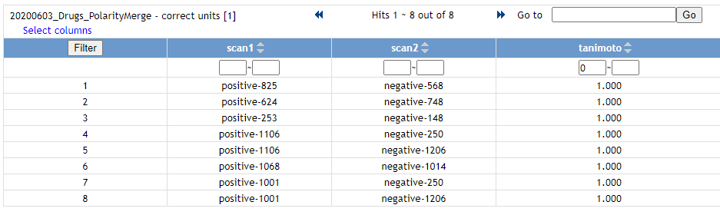
Check Quality of Merging

Slide 18
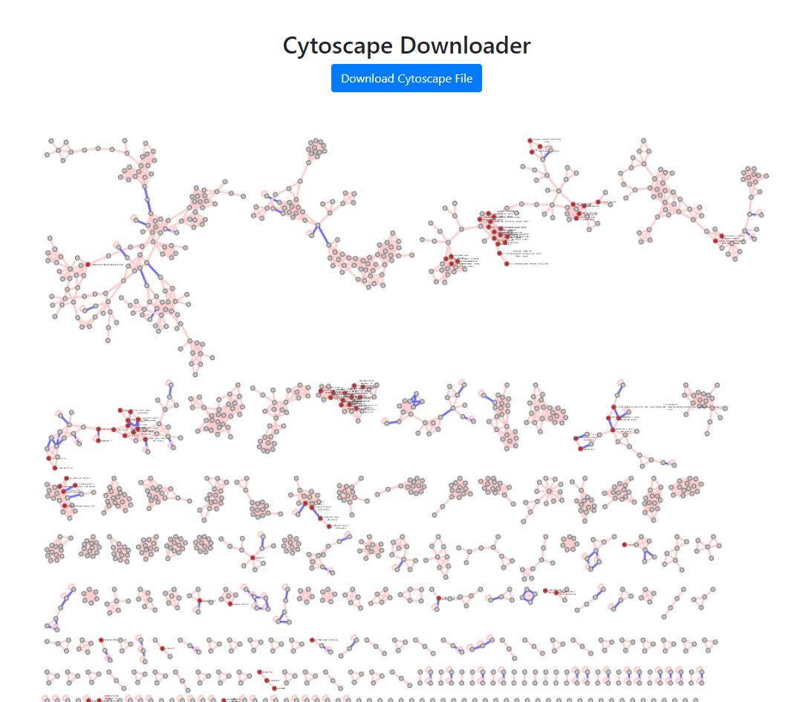
Blue Edge – Polarity Edge
Red Nodes - Identified

Slide 19
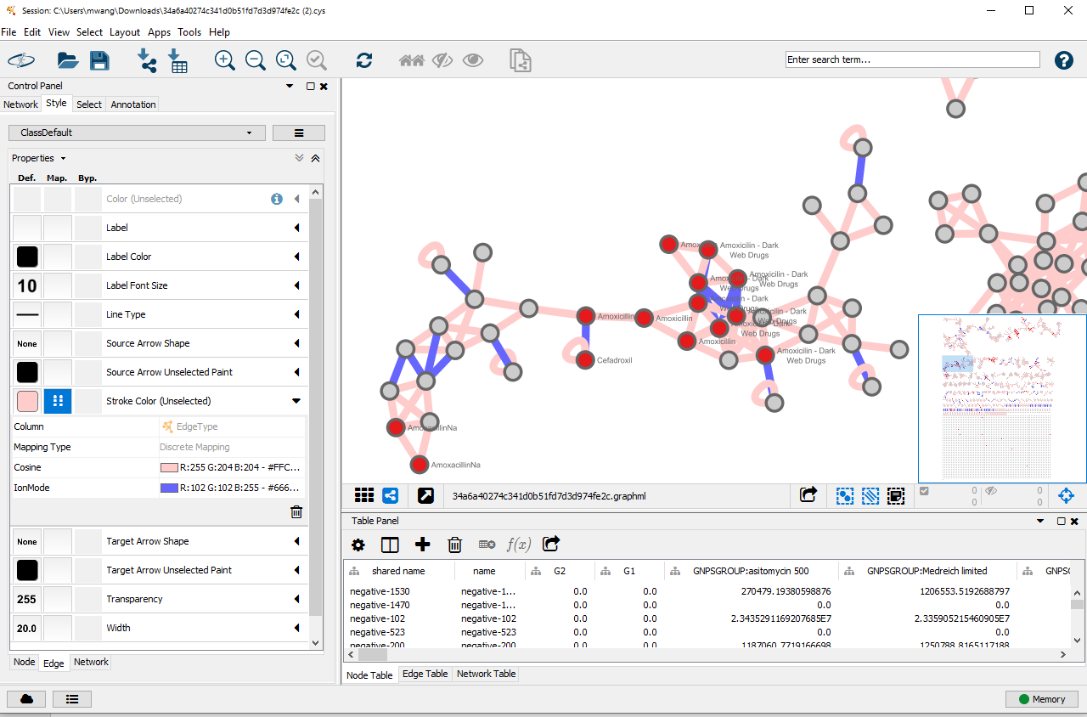
Explore your Molecular Network in Cytoscape

Slide 20
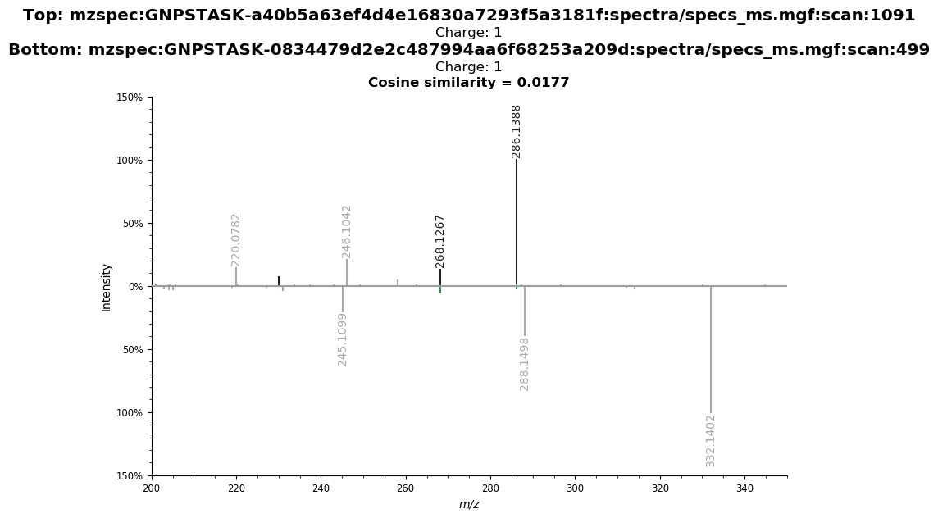
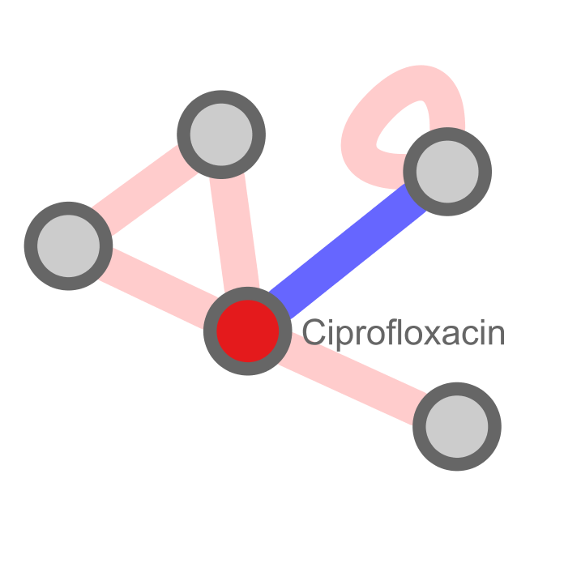
Example Of Cross Annotation
Negative mode unidentified, but can propagate from Positive
USI Link

Slide 21
Questions, Problems or Bugs?
Documentation: https://ccms-ucsd.github.io/GNPSDocumentation/
Forum: https://groups.google.com/forum/#!forum/molecular_networking_bug_reports
Allegra Aron
Alan Jarmusch
Mingxun Wang

